Slide 1
TIBCO DAY - HACKATHON
Smart Connected Cars
(Connected Intelligence)
Piyush Tamboli <Piyush.Tamboli@Infosys.com>
Saurabh Bade <saurabh.bade@infosys.com>
Atul Toke <Atul.Toke@Infosys.com>

Slide 2
Business Problem
Reliability & Service - With cars becoming a part of daily routine, customers are demanding more from reliability and service.
Omni Channel Interface – To improve seamless customer experience, we need an omni channel interface through which customer can get all the services right from car dashboard.
Real Time Stats - Car owner should know which all parts are due for service and how much time he can get it serviced.
Customer Experience - If it can be serviced while he is having a business meeting downtown.
Notes:
Please feel free to add another slide if you want to elaborate your solution in a diagram.

Slide 3
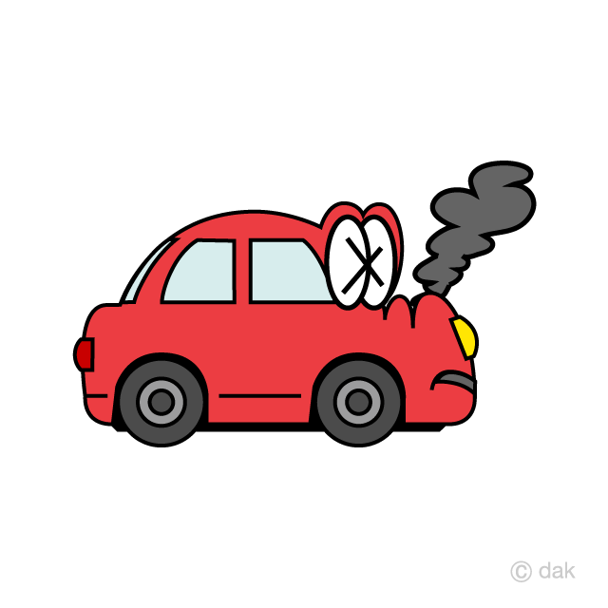
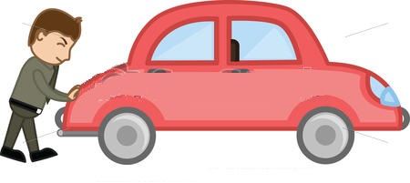
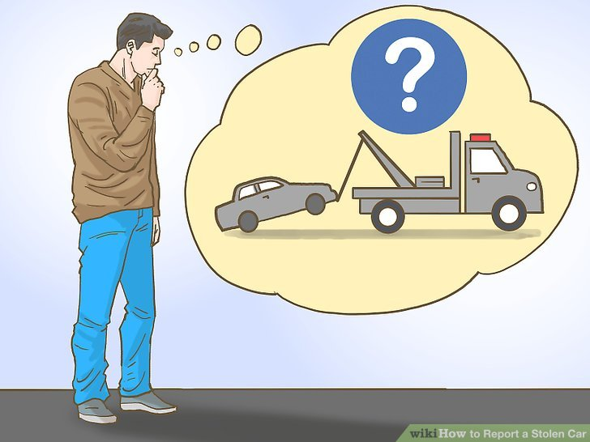

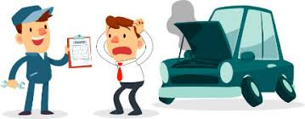
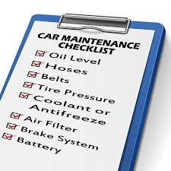


Normal Flow
Smart Flow
Notes:
Please feel free to add another slide if you want to elaborate your solution in a diagram.

Slide 4
Customer Journey 1
Car brake down in middle of nowhere
Normal Flow
Find service center number from google
Call up : IVR
Cellphone Dead, Unreliable Technician, Higher Bills
Smart Flow
Create a case from car dashboard
All the details like make model location etc. would be auto filled
Technician can probe different aspects using IoT like Engine Oil, coolant etc.
System can update the case on real time with ETA
Car Owner can see the status of the case on dashboard app, mobile app & WebApp
Notes:
Please feel free to add another slide if you want to elaborate your solution in a diagram.

Slide 5
Customer Journey 2 -
Maintenance
Normal Flow
Call up service station
Schedule pickup
For updates, call up service status
For any changes in schedule, repeat
Smart Flow
Create a case from car dashboard
All the details like make model location etc. would be auto filled
Technician can probe different aspects using IoT like Engine Oil, coolant etc.
System can update the case on real time with ETA
Car Owner can see the status of the case on dashboard app, mobile app & WebApp
Notes:
Please feel free to add another slide if you want to elaborate your solution in a diagram.

Slide 6
Proposed innovation / Solution Overview
Smart connected sensors can maintain the service history of all different components and their health. This data can be stored on cloud.
User can have a app on car dashboard using which he/she can create a case and all the relevant details can be auto-filled for case creation. User should be able to see the progress of service technician using app.
Technician should be able to probe all the relevant components for health check and carry necessary tools and provide optimum service time.
Notes:
Please feel free to add another slide if you want to elaborate your solution in a diagram.

Slide 7
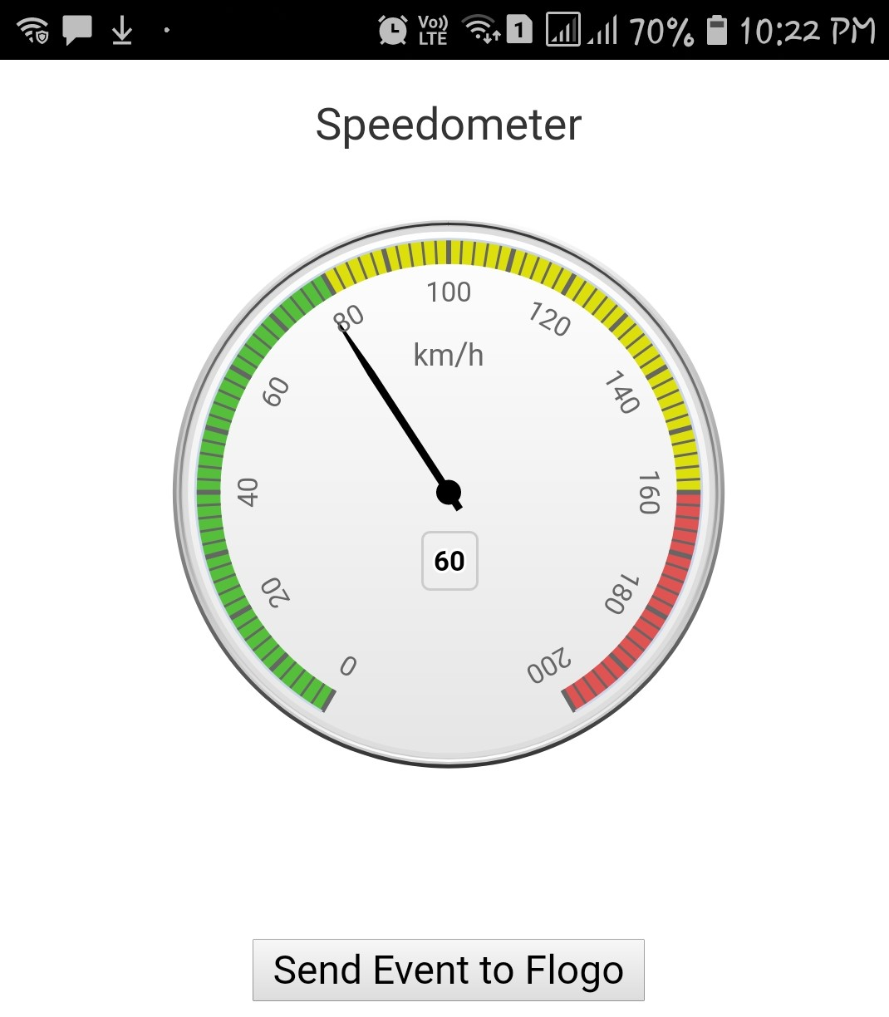
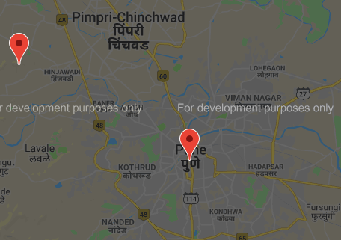
High Level Design
Smart Connected Cars
Live Apps
Flogo
Analytics
Car / Customer
Service Center
IoT Enabled Devices
Technician
Notes:
Please feel free to add another slide if you want to elaborate your solution in a diagram.

Slide 8
Highlights
Case management using Tibco Cloud Live Apps
Fetch information using Flogo and IoT
Predictive analysis using ML and IoT
Reporting for quick turn around time and better reliability
Responsive App using nodeJs
Notes:
Please feel free to add another slide if you want to elaborate your solution in a diagram.

Slide 9
Case Management Stages
Case Created
Case Assigned
Technician Started
Technician Reached
Work Estimate Updated
Work Started
Case Closed
Feedback Received
Keys Handed Over
Work Finished
Notes:
Please feel free to add another slide if you want to elaborate your solution in a diagram.

Slide 10
Key Takeaways
Customer would not have to deal with multiple interfaces like IVRs, Apps, User manuals
The solution is scalable and extendable.
There is a huge possibility of using analytics and machine learning to improve the app.
Notes:
Please feel free to add another slide if you want to elaborate your solution in a diagram.

Slide 11
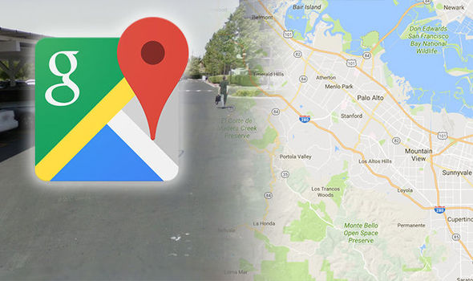

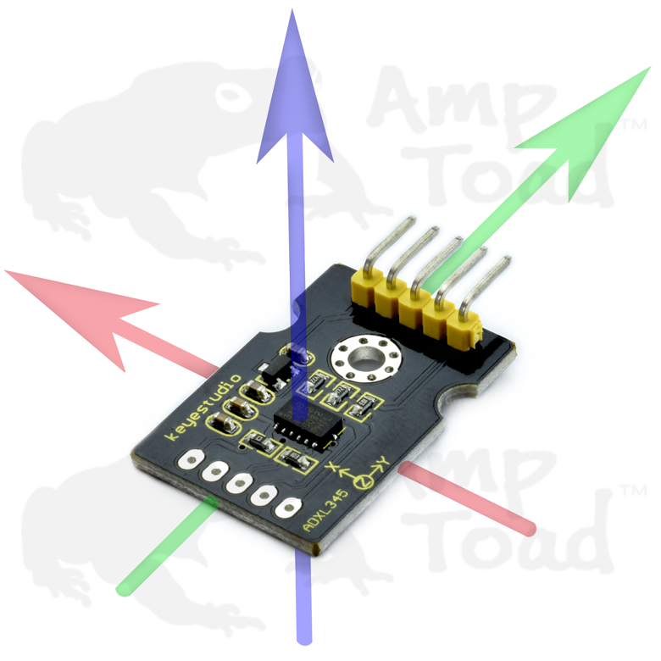
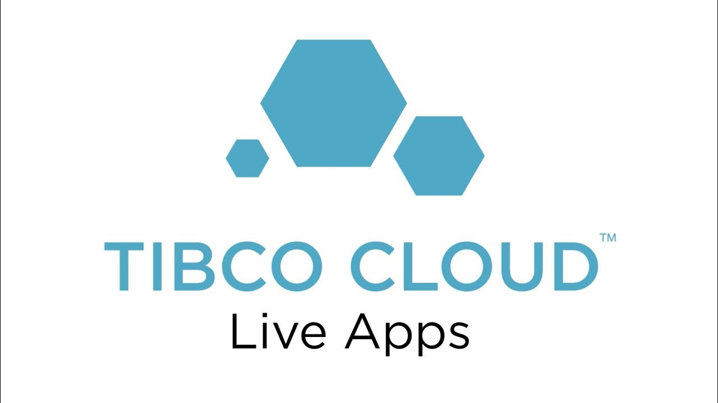
Implementation Detail
Created android app and used accelerometer api. more
Used google map api to tag service station and car location
Flogo app to receive distress signal from car/IoT app
LiveApps to manage case
Notes:
Please feel free to add another slide if you want to elaborate your solution in a diagram.

Slide 12
Let’s Have a Demo now..

Slide 13
Thank You

